Slide 1
SANS PURPLE TEAM
Threat-Informed Detection Engineering
SANS Purple Team Series

Slide 2





Jorge Orchilles
Chief Technology Officer
Principal SANS Instructor: SEC699, SEC599, SEC504
Author SEC564: Red Team Exercises and Adversary Emulation
10 years @ Citi
Projects/Contributor
Purple Team Exercise Framework (PTEF)
C2 Matrix
MITRE ATT&CK
Atomic Red Team
CVSSv3.1 Voting Member
GFMA: Threat-Led Pentest Framework
ISSA Fellow; NSI Technologist Fellow

Slide 3

Christopher Peacock
Adversary Emulation - Detection Engineer
Previous Experience:
Raytheon Intelligence & Space
Cyber Threat Intelligence, Threat Hunting, Detection Engineering, Incident Response, and Tier 3 SOC
General Dynamic Ordnance and Tactical Systems
Tier 2 SOC & Purple Team Operator
Current Certifications include:
GIAC Cyber Threat Intelligence (GCTI)
GIAC Certified Forensic Analyst (GCFA)
GIAC Certified Enterprise Defender (GCED)

Slide 4
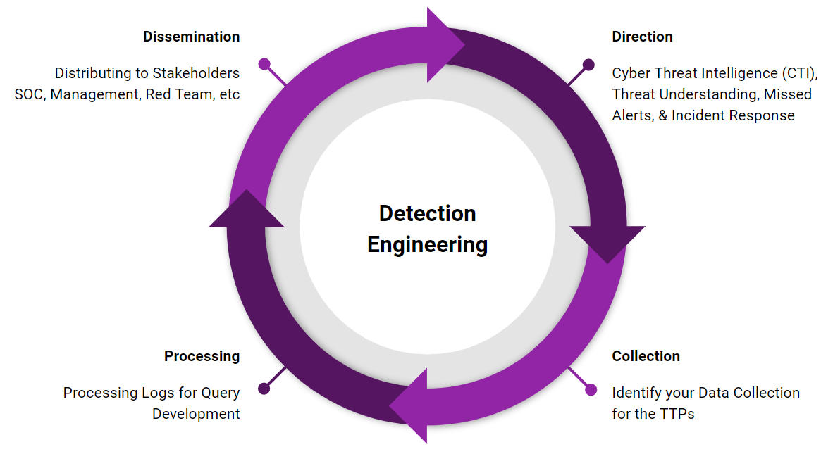
AGENDA
What is Purple Team?
What is being Threat-Informed?
Detection Engineering
Direction
Collection
Processing
Dissemination
More resources

Slide 5
What is a Purple Team?
A collaboration between various information security skill sets
A virtual, functional team working together to test, measure and improve defensive security posture (people, process, and technology)
Cyber Threat Intelligence - research and provide adversary tactics, techniques, and procedures (TTPs)
Red Team - offensive team in charge of emulating adversaries and TTPs
Blue Team - the defenders. Security Operations Center (SOC), Threat Hunting Team, Digital Forensics and Incident Response (DFIR), and/or Managed Security Service Providers (MSSP)

Slide 6
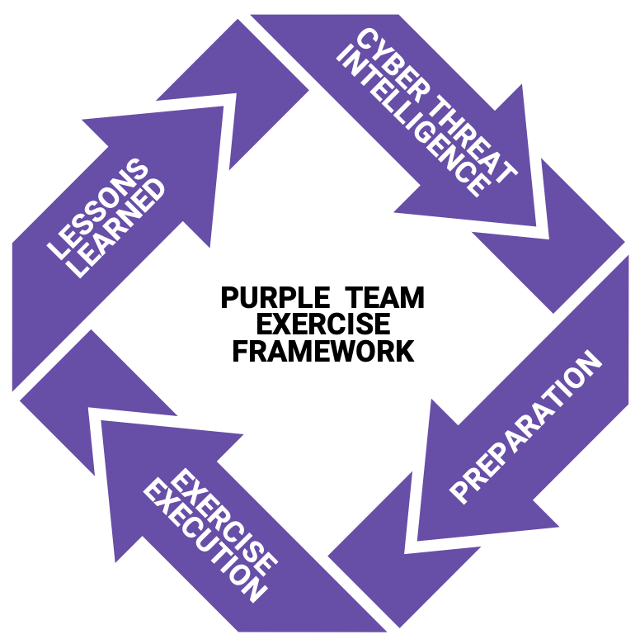
Purple Team Exercise Framework (PTEF)
SCYTHE and industry experts collaborated to create the Purple Team Exercise Framework (PTEF) to facilitate performing adversary emulations as Purple Team Exercises
Industry led vs. Regulatory led
Version 2 is out and covers Operationalized Purple Teaming
https://github.com/scythe-io/purple-team-exercise-framework
Notes:
Purple Team Exercise Framework (PTEF)
SCYTHE created a Purple Team Exercise Framework (PTEF) to facilitate the creation of a formal Purple Team Program by performing adversary emulations as Purple Team Exercises and/or Continuous Purple Teaming Operations.
While Red Team Engagements are considered “zero knowledge” engagements, where Blue Teams are unaware of the adversary emulation prior to or during the engagement, a Purple Team Exercise is a full knowledge engagement where the attack activity is exposed and explained to the Blue Team as it occurs. Purple Team Exercises are "hands-on keyboard" exercises where Red and Blue teams work together with an open discussion about each attack technique and defense expectation to improve people, process, and technology in real-time. Purple Team Exercises are Cyber Threat Intelligence led, emulating Tactics, Techniques, and Procedures (TTPs) leveraged by known malicious actors actively targeting the organization to identify and remediate gaps in the organization’s security posture.
Reference:
https://www.scythe.io/ptef

Slide 7
Purple Team Exercise Flow
Today’s focus
Exercise Coordinator (EC)
Detection Engineering
All
Red Team
Blue Team
All
Present adversary, TTPs, and technical details
Tabletop discussion of security controls and expectations for TTP execution
Emulate the TTP while sharing the screen so everyone sees and learns what an attack looks like
Follow process to detect and respond to TTPs, share screen to confirm identification of artifacts
Can any adjustments or tuning to security controls and/or logging be made to increase visibility
Repeat procedure and record new results, move to next TTP

Slide 8
Operationalized Purple Team
New CTI or TTPs
02
Analyze & Organize TTPs
01
03
Tabletop Discussion
Detection Engineering
05
04
Emulate
Attack
Today’s focus

Slide 9
The Process
Dissemination
Distributing to Stakeholders SOC, Management, Red Team, etc
Direction
Cyber Threat Intelligence (CTI), Threat Understanding, Missed Alerts, & Incident Response
Detection Engineering
Processing
Processing Logs for Query Development
Collection
Identify your Data Collection for the TTPs
Notes:
Direction - CTI provides threats for our detection capabilities to focus on. You may have a multiple teams providing this direction including, an intel team, a DFIR team, or a red team. It could be from your own threat intel collection such as reading about a new technique posted on twitter that your adversaries are likely to adopt. It’s also important to note that with the cycle direction may come from the SOC as well to fix an alert.
Collection - We need to know what the threat would look like in our environment. We may have have a red team or the CTI team emulate the threat or do it ourselves, but the end goal is to generate and collect logs for what the threat looks like inside our security stack. If any logging gaps are identified, they should be fixed or documented as gaps.
Where are the logs
Where are the gaps
Start hypothesising detection opportunities
Processing - Processing is were we hunt through logs for detection opportunities. At first we cast a wide net, and then hunt through the data to narrow it down to suspicious activity. While we conduct this hunt we in turn are developing a query to emplemete as an alert.
Dissemination - This step is where we give stakeholders our deliverables.
For SOC it may be an alert, with documented reasoning, context, and potential responses.
Management or the CTI team may want to record the content to see what MITRE ATT&CK ID is covered or log sources use.
We may distribute to the Red Team for them to come up with procedures to bypass the alerting and drive a new Direction and start another cycle.

Slide 10
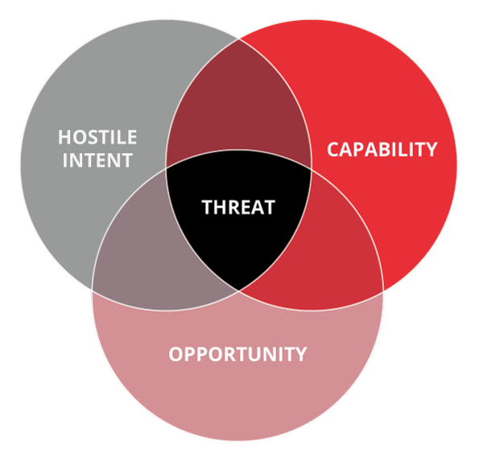
Components of a threat
https://www.incibe-cert.es/en/blog/active-defence-and-intelligence-threat-intelligence-industrial-environments
Notes:
Knowing Intent allows us to focus on what adversaries to study. Understanding Capability allows us to focus our detections on the TTPs of those targeting us.

Slide 11
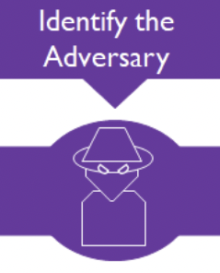


Cyber Threat Intelligence
Notes:
Does the adversary target organizations like ours?

Slide 12
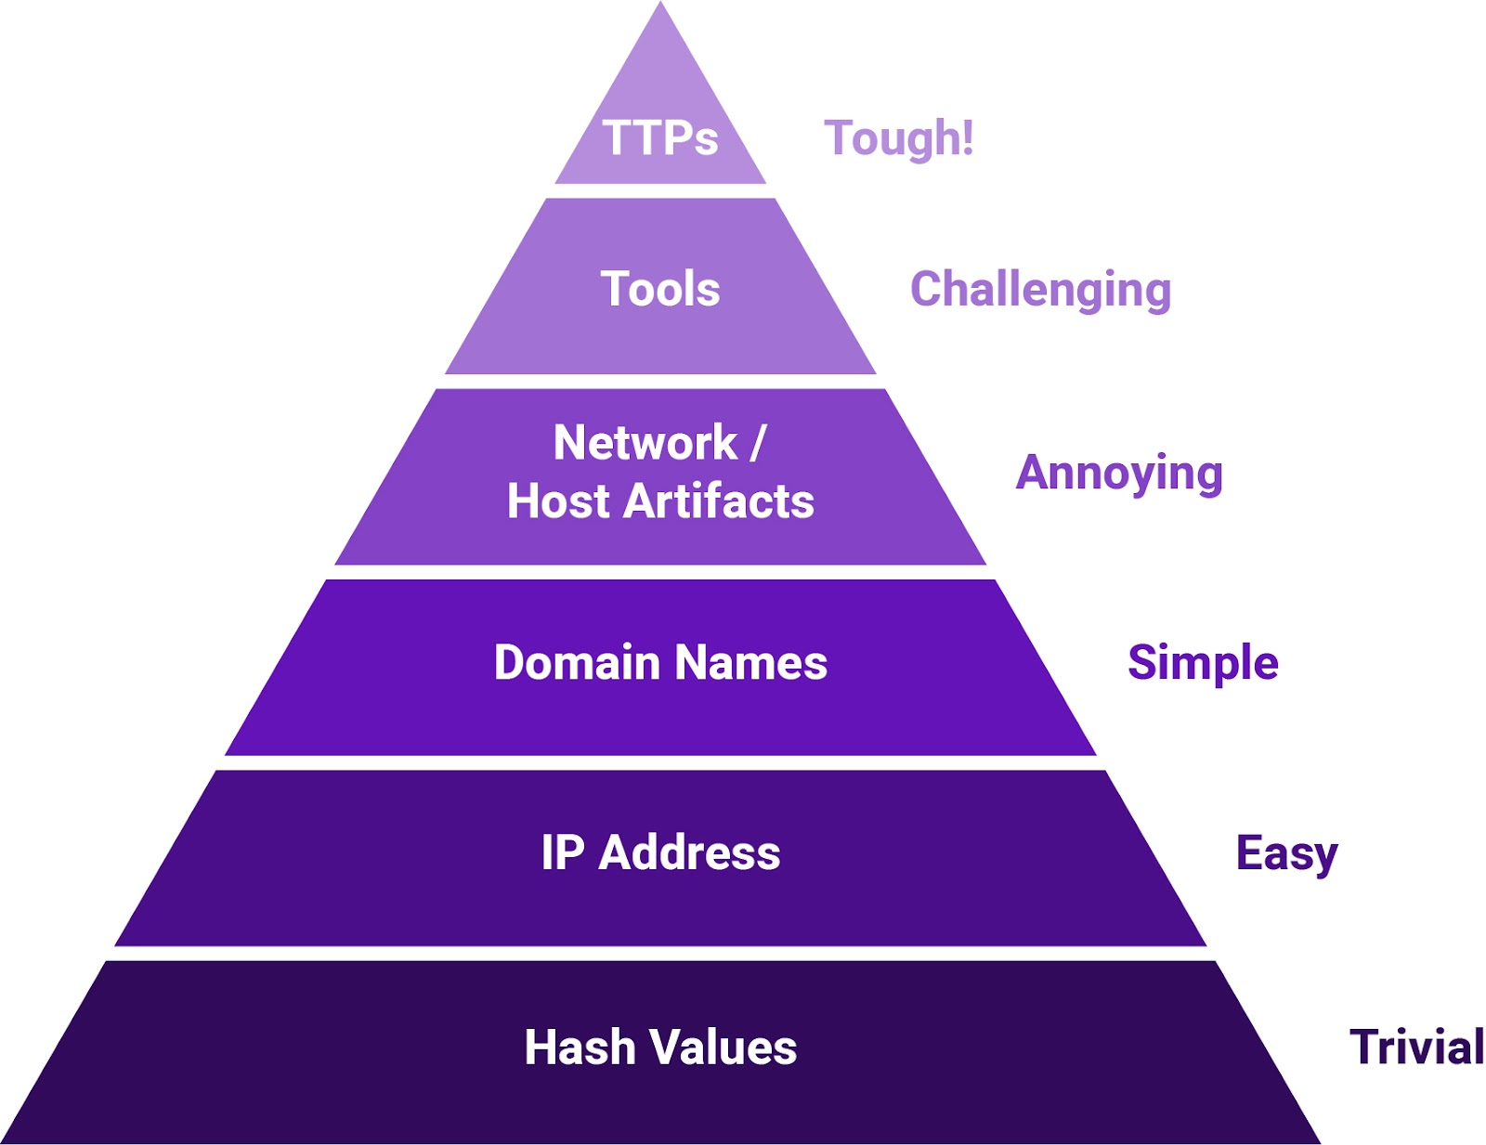
Pyramid of pain
David Bianco: http://detect-respond.blogspot.com/2013/03/the-pyramid-of-pain.html

Slide 13

Tactics, techniques, and procedures are not the same level

Slide 14
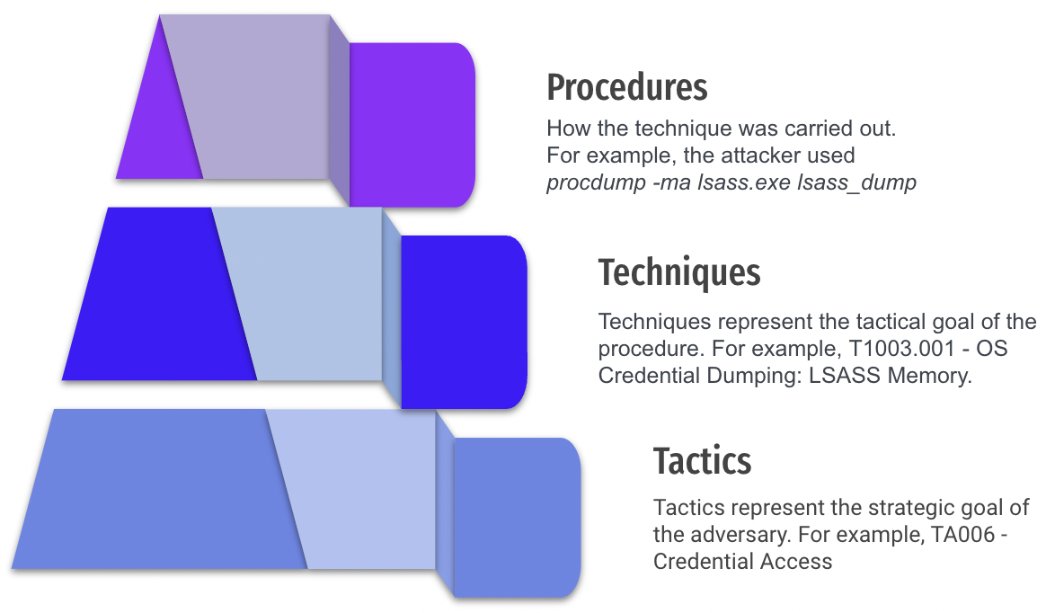
TTP Pyramid
https://www.scythe.io/library/summiting-the-pyramid-of-pain-the-ttp-pyramid

Slide 15
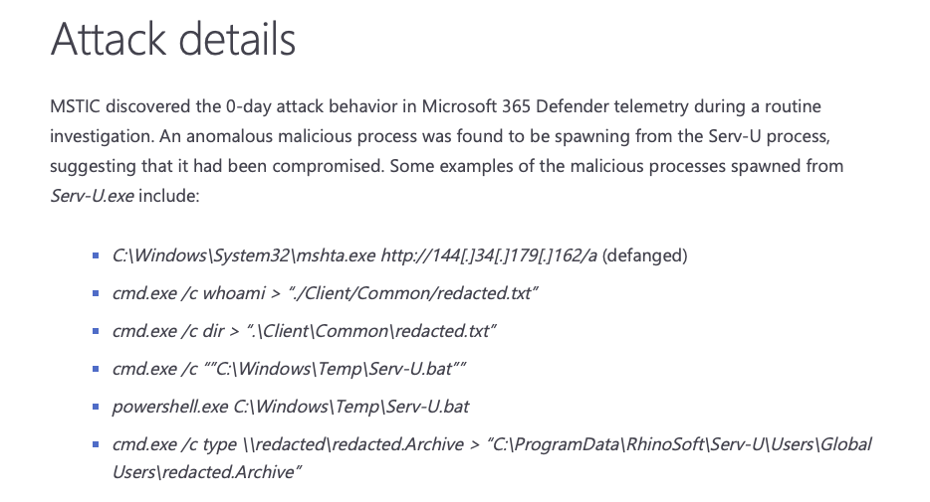
Extracting Procedures
Microsoft discovers threat actor targeting SolarWinds Serv-U software with 0-day exploit
Mshta.exe with WAN connection
Whoami execution
With output to .txt file
https://www.microsoft.com/security/blog/2021/07/13/microsoft-discovers-threat-actor-targeting-solarwinds-serv-u-software-with-0-day-exploit/

Slide 16
Human Element
What procedures are the adversary using?
Habits
Training
Tools
Guides (check out Conti)
Copy and paste from guide

Slide 17
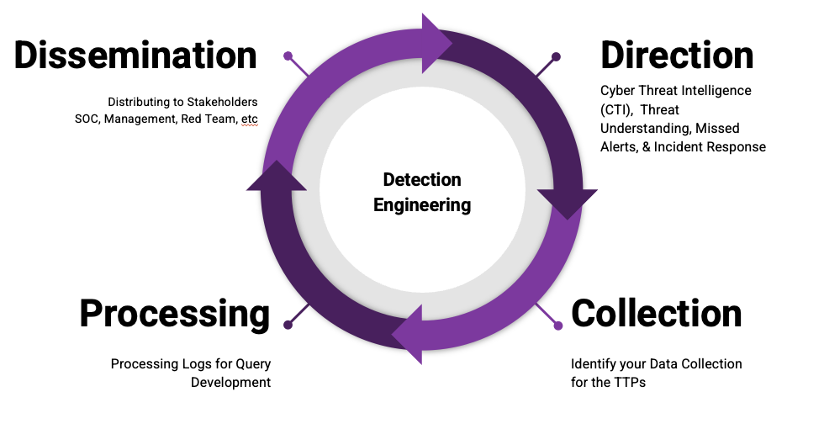
Detection Engineering process

Slide 18
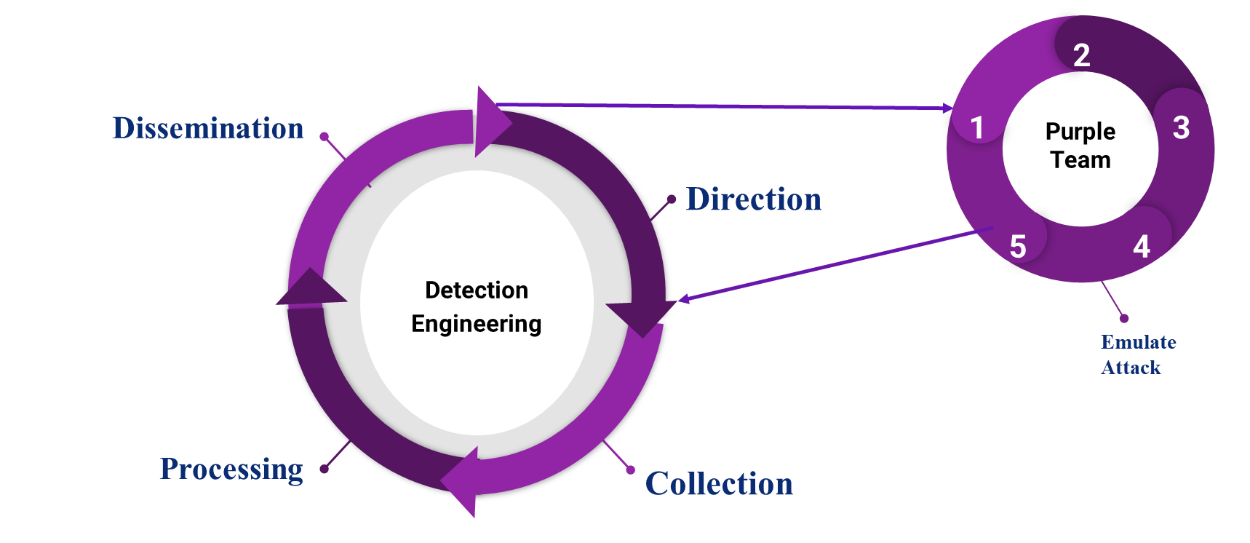
Operationalized Purple Team: Detection ENGINEERING
Notes:
New CTI/TTPs Analyze and Organize Develop a plan Tabletop before executing Emulation

Slide 19
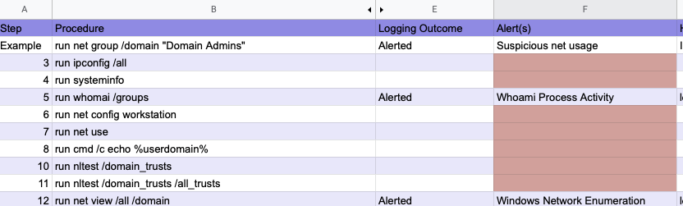
Purple Team Direction

Slide 20
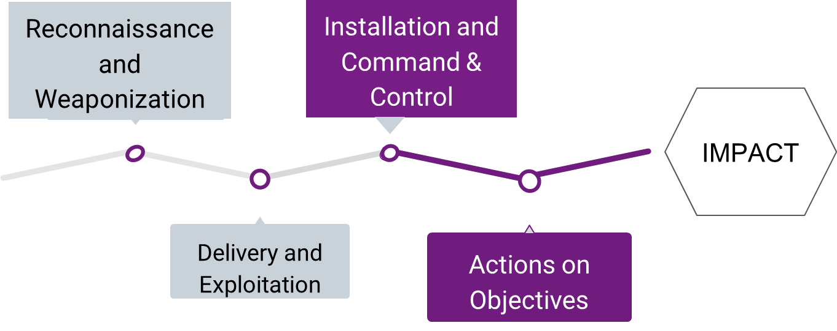
Detection Focus

Slide 21
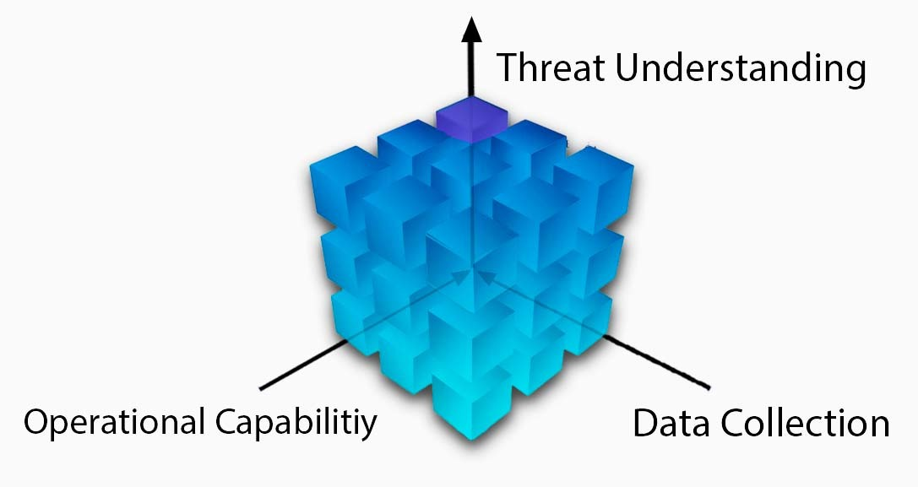
Strategic Drivers

Slide 22
Data Collection
What data are you collecting?
Where is it collected?
SIEM, EDR, Firewall?
How do you prioritize Data Sources?

Slide 23
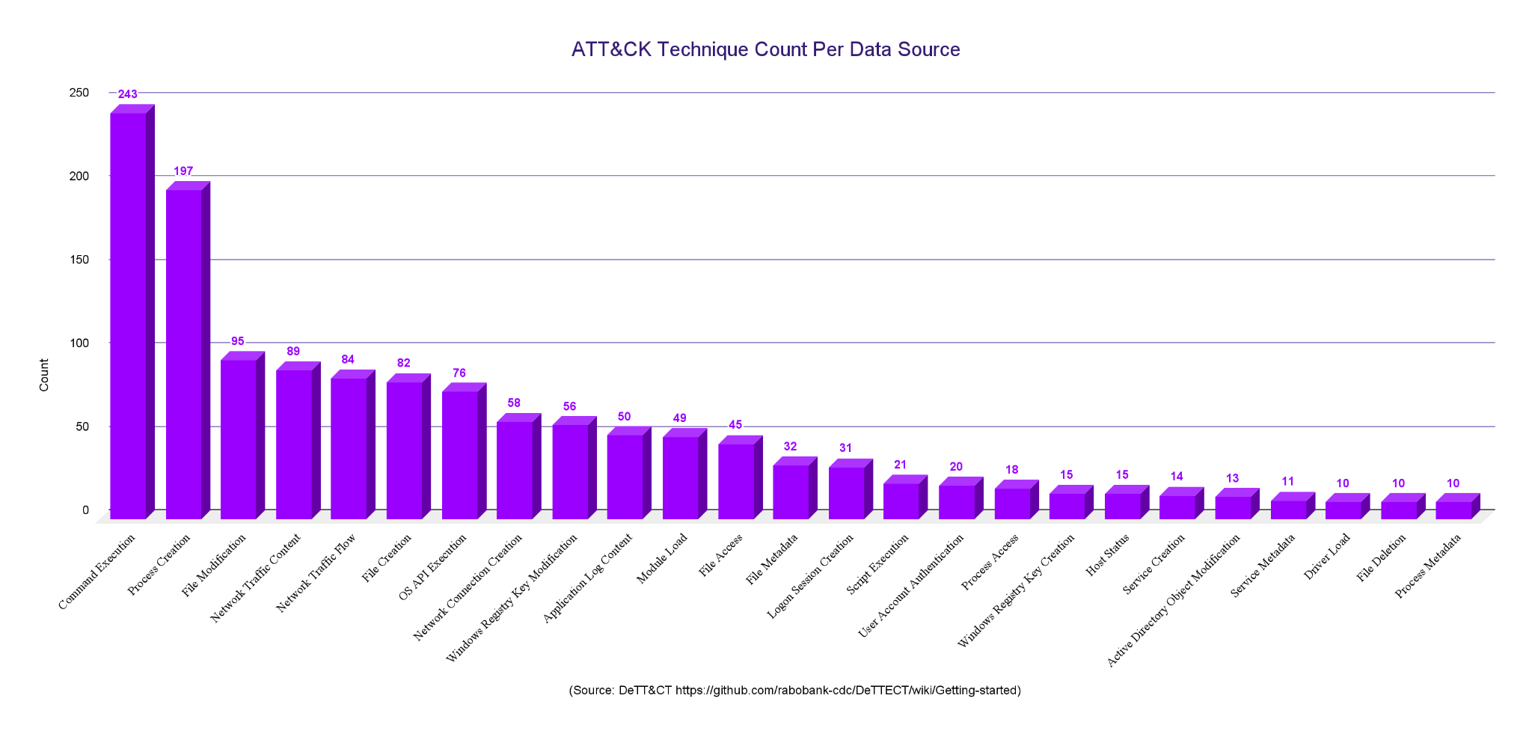
Data Collection

Slide 24
Operational capacity
The Detection Cyborg
The level of capability and proficiency between the Analyst and their Tools.
Great analyst can be hindered by inefficient tools.
Great tools will be underutilized by novice analysts.
Time factor.

Slide 25
Threat Understanding
Understanding your threat landscape is crucial.
Example: If you don’t know PowerShell is used in malicious activity, you won’t try to detect it.
Focus on Procedures
Not Technique Level
Not Atomic IOCs or “Threat” Feeds

Slide 26
Collection
Verify data is collected around the event(s).
MITRE ATT&CK can assist in identifying data sources.
Where are the logs found?
SIEM, EDR, Host, etc
Check out DeTT&CT
Are there visibility gaps in the logs?
If logging gaps are identified, they should be fixed or documented as gaps.
Start hypothesizing detection opportunities
Dissemination
Direction
Processing
Collection
Notes:
Collection - We need to know what the threat would look like in our environment. We may have have a red team or the CTI team emulate the threat or do it ourselves, but the end goal is to generate and collect logs for what the threat looks like inside our security stack.

Slide 27
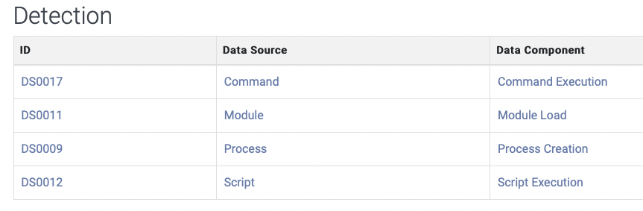
Collection: Data Source Components
What logs are potentially needed to write an alert for the procedure?
Use the Detection Section on MITRE ATT&CK pages.
In this example we see the Data Components for Command and Scripting Interpreter: PowerShell, ID: T1059.001.
https://attack.mitre.org/techniques/T1059/001/

Slide 28
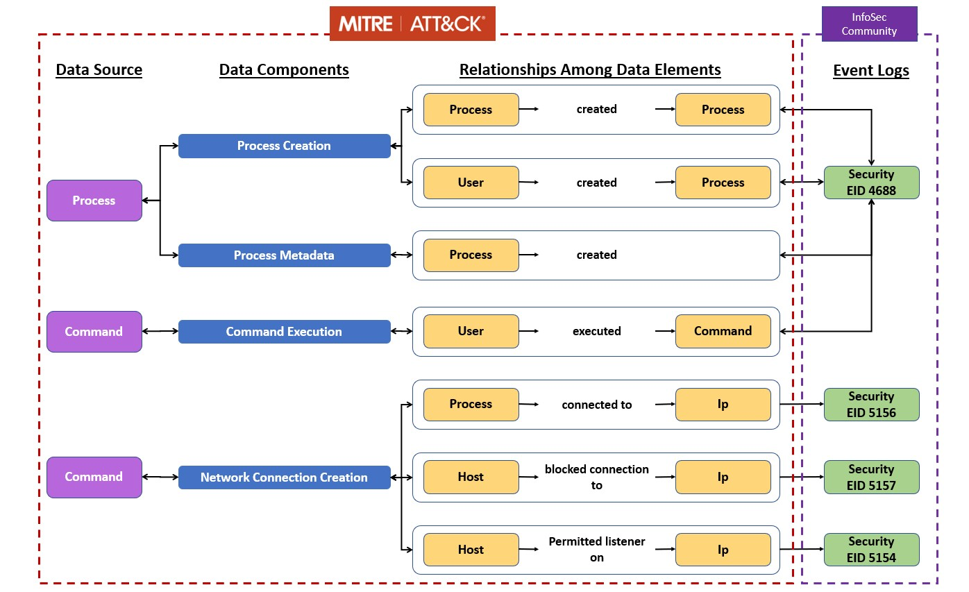
Collection: Data Sources to Logs
https://github.com/mitre-attack/attack-datasources

Slide 29
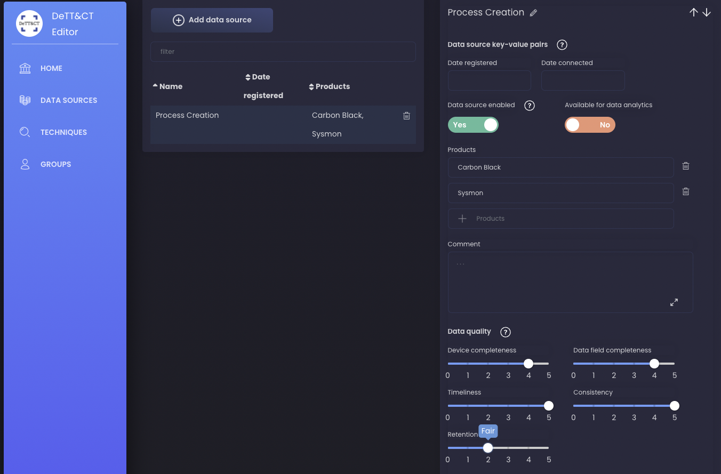
Collection: DeTT&CT
https://rabobank-cdc.github.io/dettect-editor/

Slide 30
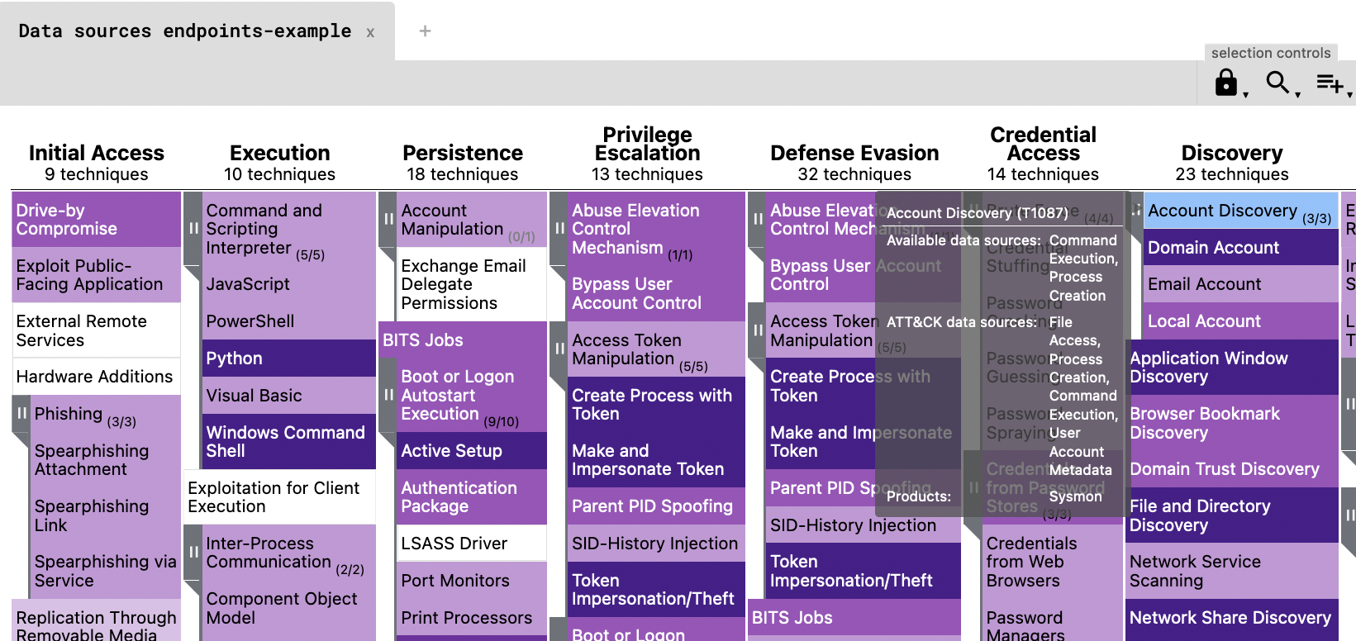
Collection: DeTT&CT
DeTT&CT can visualize log source coverage
https://rabobank-cdc.github.io/dettect-editor/
Notes:
Shows coverage on ATT&CK Navigator here we see the product is sysmon

Slide 31
Processing
Hypothesize detection opportunities.
One source or correlations between sources.
Test a hypothesis by casting a wide net.
Narrowing the search until there are limited false positives.
Dissemination
Direction
Processing
Collection
Notes:
Processing - Processing is were we hunt through logs for detection opportunities. At first we cast a wide net, and then hunt through the data to narrow it down to suspicious activity. While we conduct this hunt we in turn are developing a query to emplemete as an alert.

Slide 32
Developing Hypothesis
Microsoft discovers threat actor targeting SolarWinds Serv-U software with 0-day exploit
Mshta.exe with WAN connection
Whoami execution
May scope to execution with certain command line parameters
https://www.microsoft.com/security/blog/2021/07/13/microsoft-discovers-threat-actor-targeting-solarwinds-serv-u-software-with-0-day-exploit/

Slide 33
Processing questions
What are the parts of procedure and how are they used maliciously?
cmd.exe /c whoami > “./Client/Common/redacted.txt”
Notes:
Procedure can be leveraging an application, writing a reg key, a specific command, or an alteration of variables

Slide 34
Processing questions
cmd launches whoami
Uses > to output to txt
cmd.exe /c whoami > “./Client/Common/redacted.txt”
cmd launches whoami
cmd cmd launches whoami
launches whoami
The adversary uses cmd to enumerate the user via whoami and outputs the command line response to a text file using the “>” redirect command.
Notes:
Procedure can be leveraging an application, writing a reg key, a specific command, or an alteration of variables

Slide 35
Processing questions
How often do the components appear in normal operations?
How often is whoami used?
cmd.exe /c whoami > “./Client/Common/redacted.txt”
How often does cmd launch whoami?
Is it common for whoami to be redirected to a txt file?
Notes:
Procedure can be leveraging an application, writing a reg key, a specific command, or an alteration of variables

Slide 36
Processing questions
Are there common parent processes you can tune out or tune into?
What process starts this chain?
cmd.exe /c whoami > “./Client/Common/redacted.txt”
How often does cmd.exe launch whoami.exe?
Notes:
Procedure can be leveraging an application, writing a reg key, a specific command, or an alteration of variables

Slide 37
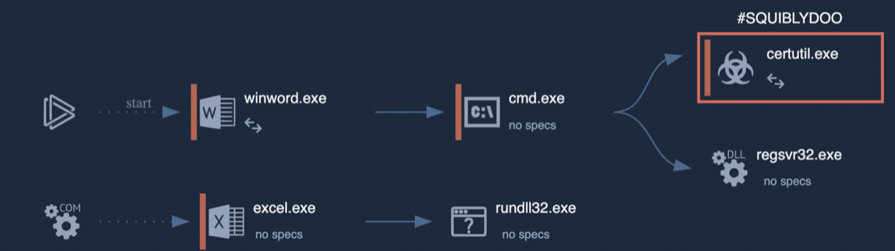
Processing questions
Are there common child processes you can tune out or tune into?
https://blog.malwarebytes.com/threat-analysis/2020/07/chinese-apt-group-targets-india-and-hong-kong-using-new-variant-of-mgbot-malware/
Notes:
Procedure can be leveraging an application, writing a reg key, a specific command, or an alteration of variables

Slide 38
Processing questions
Common command line parameters you can tune out or into?
cmd.exe /c whoami > “./Client/Common/redacted.txt”
What’s using the “>” redirector in our environment?
Notes:
Procedure can be leveraging an application, writing a reg key, a specific command, or an alteration of variables

Slide 39
Processing questions
Are there users we can tune in or out?
cmd.exe /c whoami > “./Client/Common/redacted.txt”
What users run whoami in our environment?
Notes:
Procedure can be leveraging an application, writing a reg key, a specific command, or an alteration of variables

Slide 40
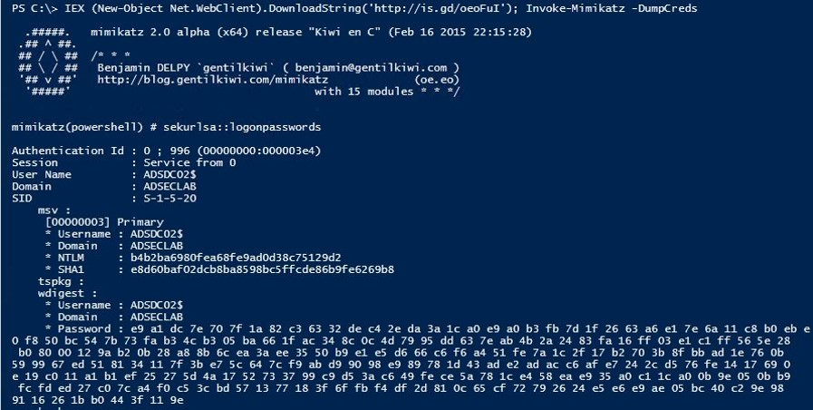
Processing questions
Does the process make network connections? Localhost, Private IPs, External IPs?
https://adsecurity.org/?p=2604
Notes:
Procedure can be leveraging an application, writing a reg key, a specific command, or an alteration of variables

Slide 41
Processing visualization
Casting a wide net
Malicious Events
Benign Events
Notes:
It’s here we start, sometime we cast and we get few benign events. Often when we cast, we end up with plenty of benign to tune.

Slide 42
Processing visualization
Don’t become too precise
Malicious Events
Benign Events
Notes:
It’s here we start, sometime we cast and we get few benign events. Often when we cast, we end up with plenty of benign to tune.

Slide 43
Processing visualization
Embrace a certain level of false positives
Malicious Events
Benign Events
Notes:
It’s here we start, sometime we cast and we get few benign events. Often when we cast, we end up with plenty of benign to tune.

Slide 44
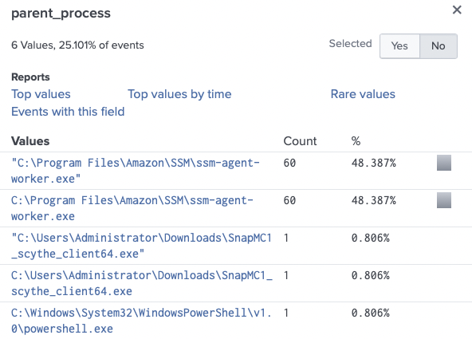
Processing: Quick Example
Tuning WMIC Execution - 30 Day Search
Here we would tune out ssm-agent-worker
Dissemination
Direction
Processing
Collection
Notes:
Processing - Processing is were we hunt through logs for detection opportunities. At first we cast a wide net, and then hunt through the data to narrow it down to suspicious activity. While we conduct this hunt we in turn are developing a query to emplemete as an alert.

Slide 45
Dissemination
Deliver to stakeholders
SOC deliverable may be an alert, with documented reasoning, context, and potential responses.
Management or the CTI team may want to record the content to see what ATT&CK ID is covered or log source(s) used.
Distribute to the Red Team for alert and bypass alert testing.
Dissemination
Direction
Processing
Collection
Notes:
Dissemination - This step is where we give stakeholders our deliverables.
For SOC it may be an alert, with documented reasoning, context, and potential responses.
Management or the CTI team may want to record the content to see what MITRE ATT&CK ID is covered or log sources use.
We may distribute to the Red Team for them to come up with procedures to bypass the alerting and drive a new Direction and start another cycle.

Slide 46
Dissemination: Structure
Leverage Palantir’s Alerting and Detection Strategy (ADS) Framework.
The Framework breaks down Tactical and Operational objectives into a concise structure:
Goal
Categorization
Strategy Abstract
Technical Context
Blind Spots and Assumptions
False Positives
Validation
Priority
Response
Dissemination
Direction
Processing
Collection
Notes:
Dissemination - This step is where we give stakeholders our deliverables.
For SOC it may be an alert, with documented reasoning, context, and potential responses.
Management or the CTI team may want to record the content to see what MITRE ATT&CK ID is covered or log sources use.
We may distribute to the Red Team for them to come up with procedures to bypass the alerting and drive a new Direction and start another cycle.

Slide 47
RINSE & REPEAT
New CTI or TTPs
02
Analyze & Organize TTPs
01
03
Tabletop Discussion
Detection Engineering
05
04
Emulate
Attack

Slide 48
More Resources
SANS Purple Team:
https://www.sans.org/purple-team/
Blogs:
https://www.sans.org/blog/?focus-area=purple-team
Detection Engineering Workshop:
https://www.scythe.io/purple-team-workshops
SANS Courses
SEC599: Defeating Advanced Adversaries - Purple Team Tactics & Kill Chain Defenses
SEC699: Purple Team Tactics - Adversary Emulation for Breach Prevention & Detection

Slide 49
SANS PURPLE TEAM COURSES
SEC504 -> SEC599 -> SEC699
What are the key differences?
SEC599
Defeating Advanced Adversaries
Purple Team Tactics & Kill Chain Defenses
SEC699
Advanced Purple Team Tactics
Adversary Emulation for Breach Prevention & Detection
Purple Team class: Focus on Red (20%) & Blue (80%)
Purple Team class: Focus on Red (50%) & Blue (50%)
20% emulation, 50% prevention, 30% detection
50% emulation, 50% detection (0% prevention)
50% lecture - 50% hands-on
40% lecture - 60% hands-on
Notes:
SANS Purple Team Courses
SEC599 – Defeating Advanced Adversaries – Purple Team Tactics & Kill Chain Defenses
Purple Team class: Focus on Red (20%) & Blue (80%)
20% emulation, 50% prevention, 30% detection
50% lecture – 50% hands-on
SEC699 – Advanced Purple Team Tactics – Adversary Emulation for Breach Prevention & Detection
Purple Team class: Focus on Red (50%) & Blue (50%)
50% emulation, 0% prevention, 50% detection
40% lecture – 60% hands-on

Slide 50
SANS PURPLE TEAM
Thank You!
Questions?
@JorgeOrchilles @SecurePeacock

